Slide 1
Android
Lab 03
2017-2018

Slide 2
Agenda
TODO list application
ListView
GridView
Creating New Activity
Intents

Slide 3
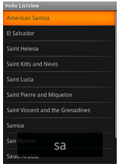
ListView
ListView is a ViewGroup that creates a list of scrollable items.

Slide 4
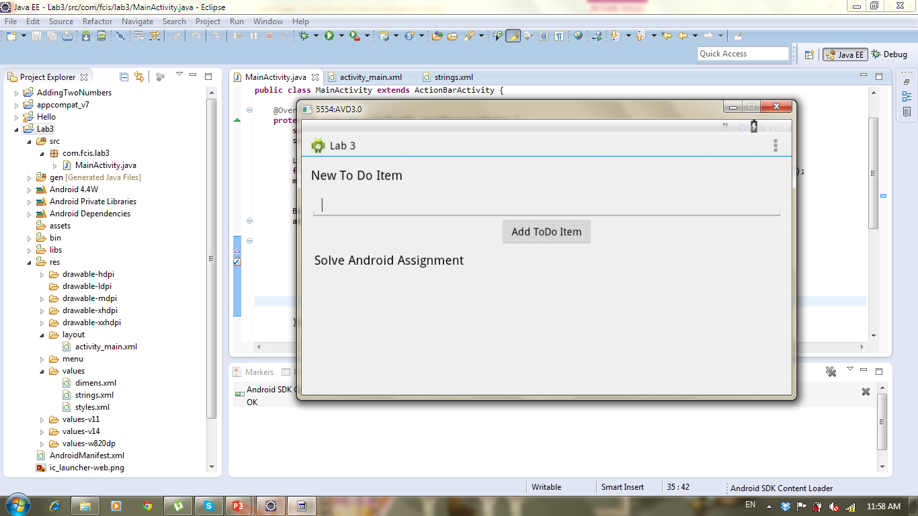
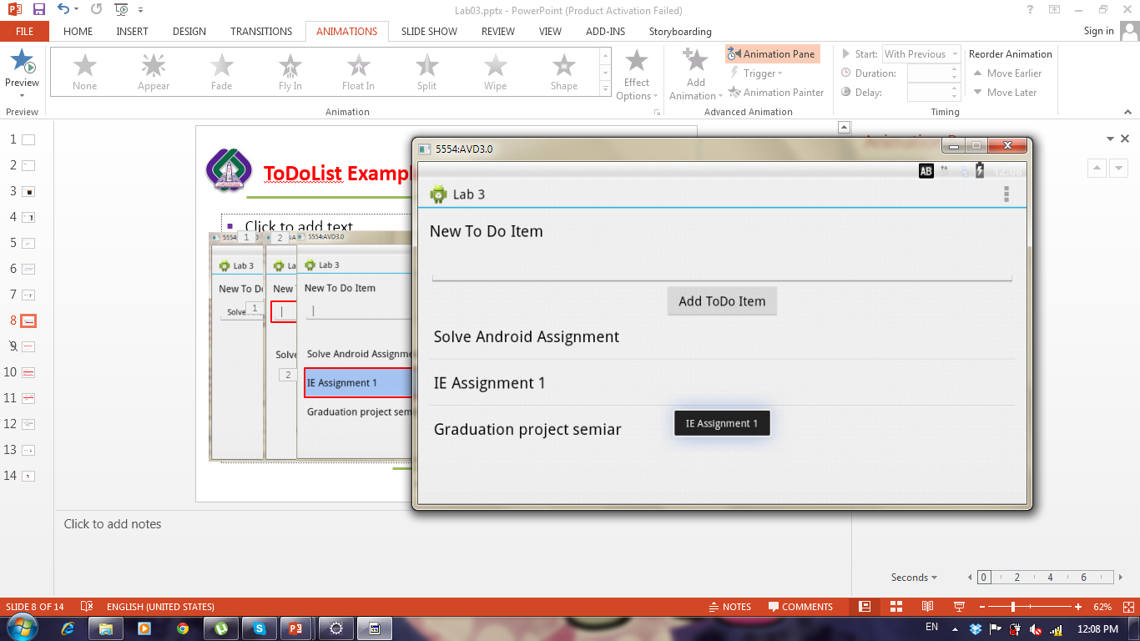
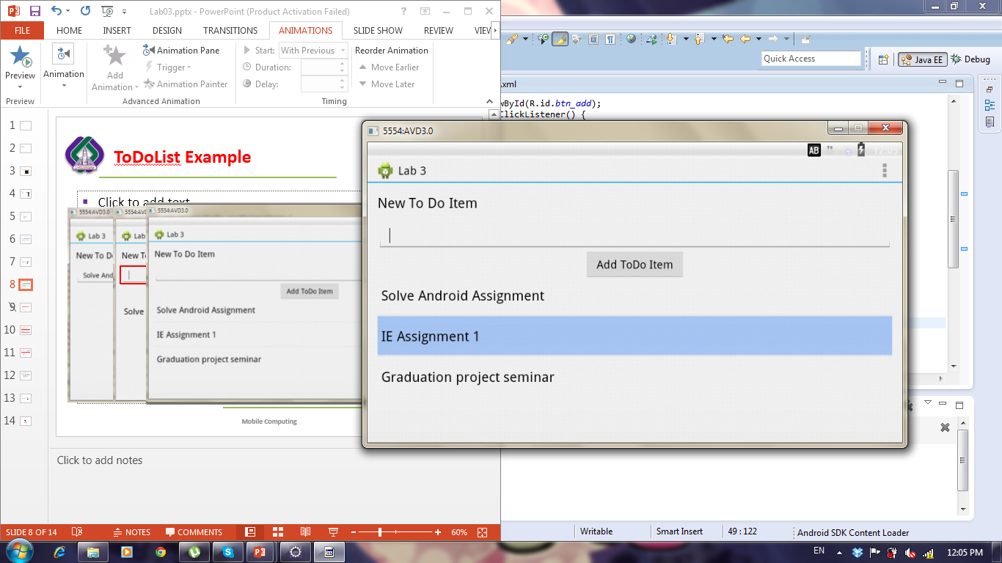
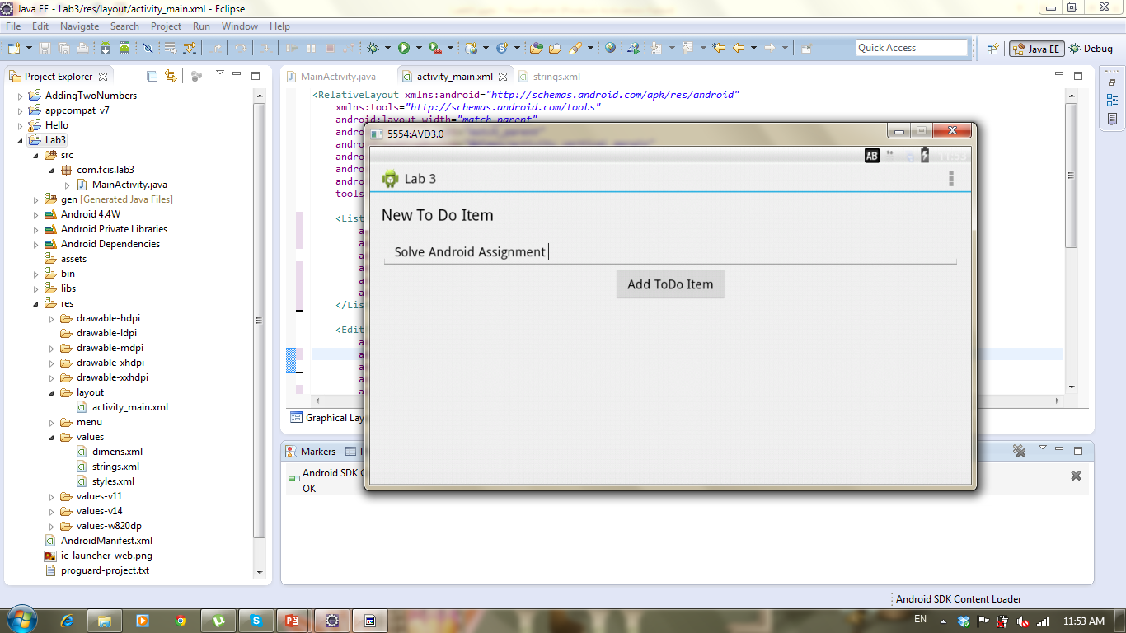
Application

Slide 5
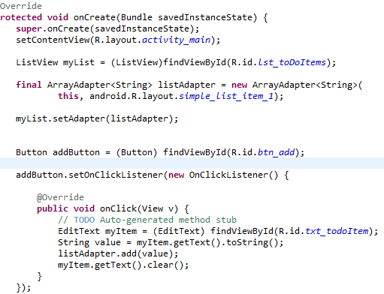
Get Listview
Generate adapter to bind values to listView
Set ListView’s adapter with our adapter
Get button and add click listener
Get Text from edittext, add it to adapter then clear edittext
Notes:
ArrayAdapter<String>aa=new ArrayAdapter<String>(getApplicationContext(), android.R.layout.simple_list_item_single_choice,ss);
lv.setChoiceMode(ListView.CHOICE_MODE_SINGLE);
Adapters are not only used by ListView, but also by other views which extend AdapterView as, for example, Spinner, GridView, Gallery and StackView.
To add or delete item the adapter should be linked with arrayList not String[]
https://github.com/codepath/android_guides/wiki/Using-an-ArrayAdapter-with-ListView

Slide 6
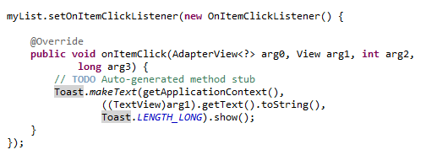
Application: How to show todoitem text when clicking it using Toast
Add itemClickListener On ListView
Show Message to user using Toast Class

Slide 7

Application
30 Minutes
GUI - Update Texts and IDs
Add Functionality

Slide 8
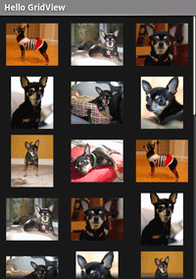
GridView
GridView is a ViewGroup that displays items in a two-dimensional, scrollable grid.

Slide 9
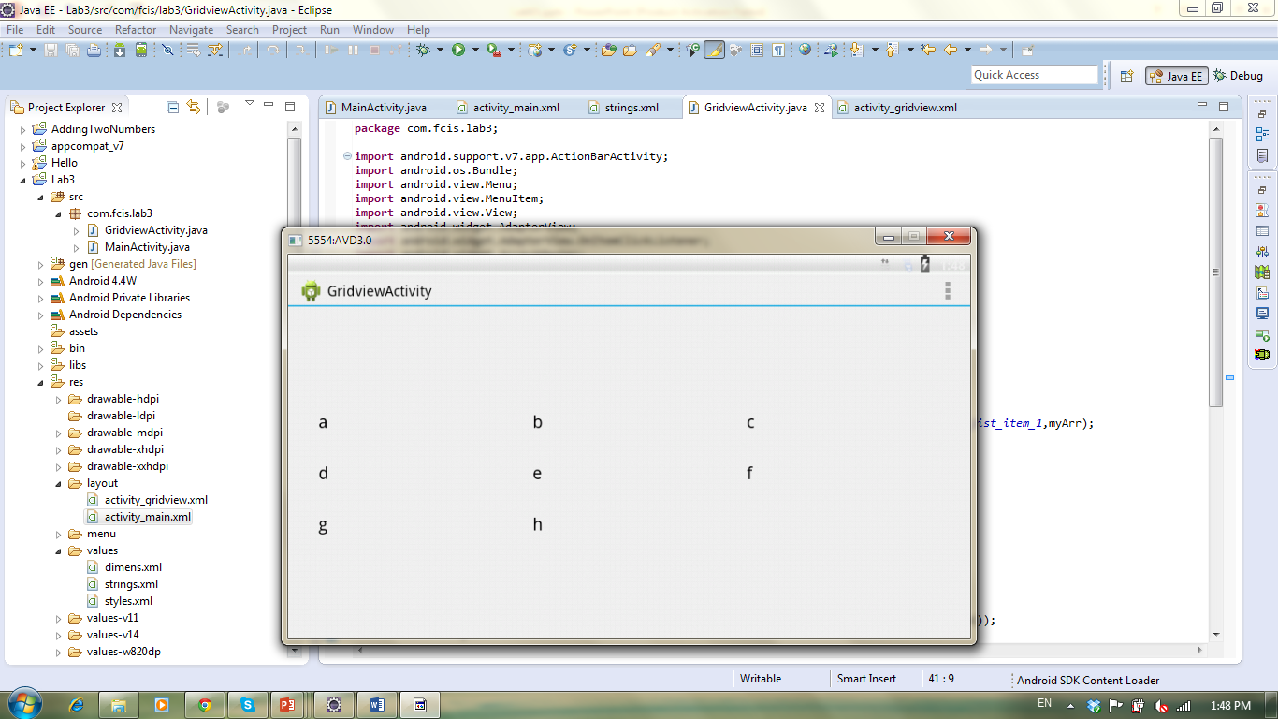
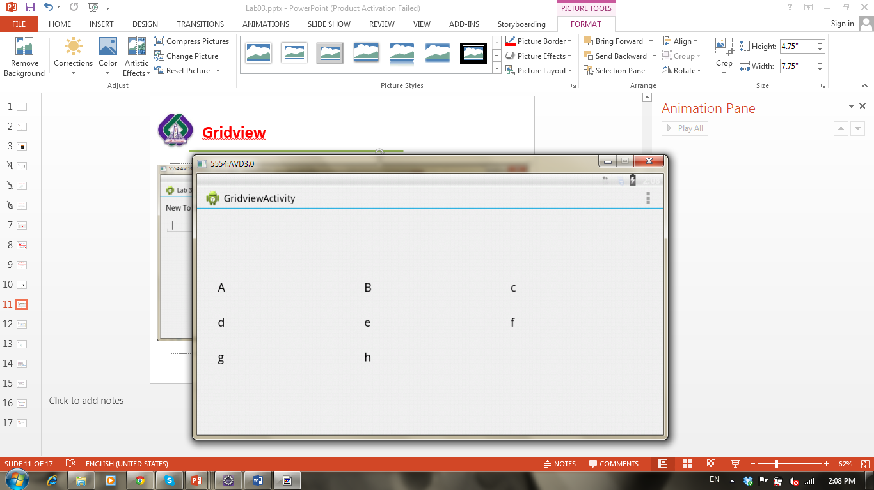
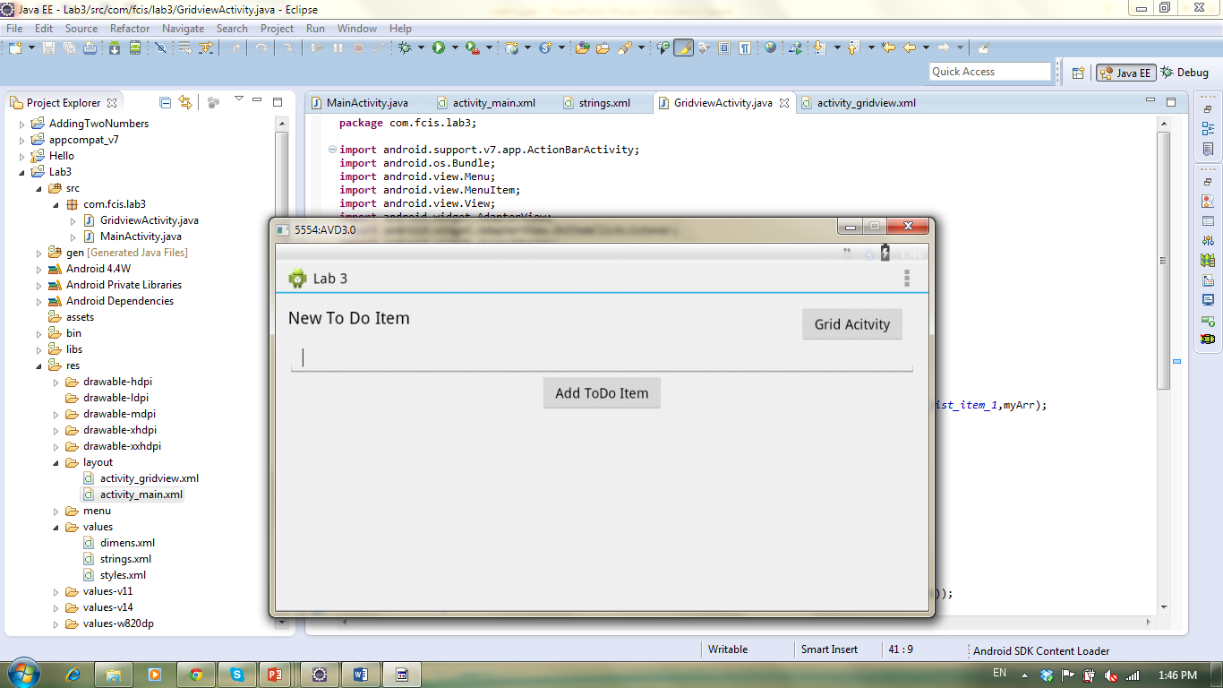
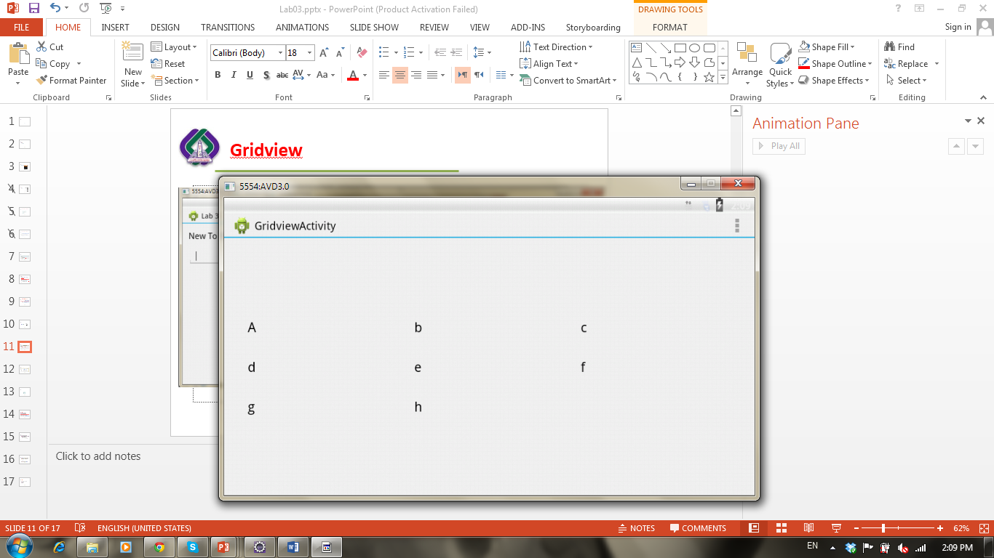
Application

Slide 10
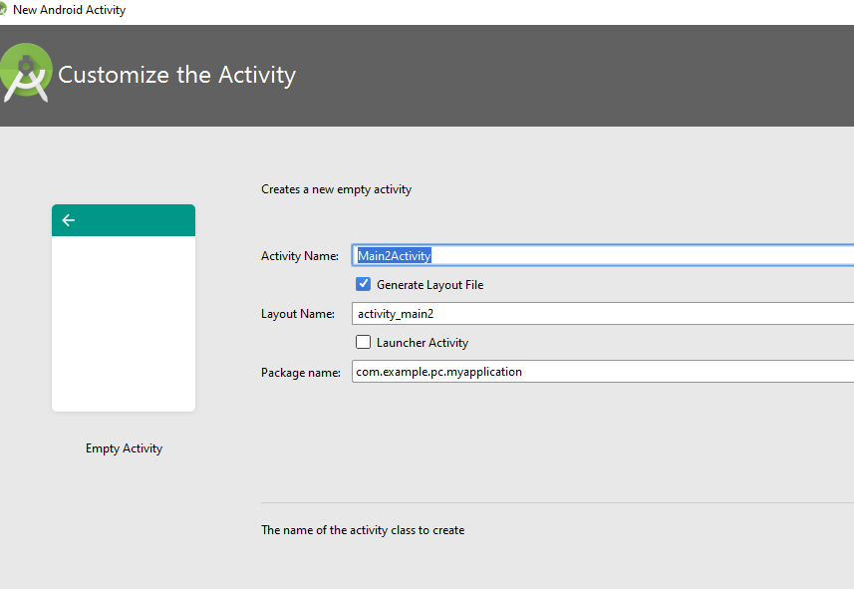
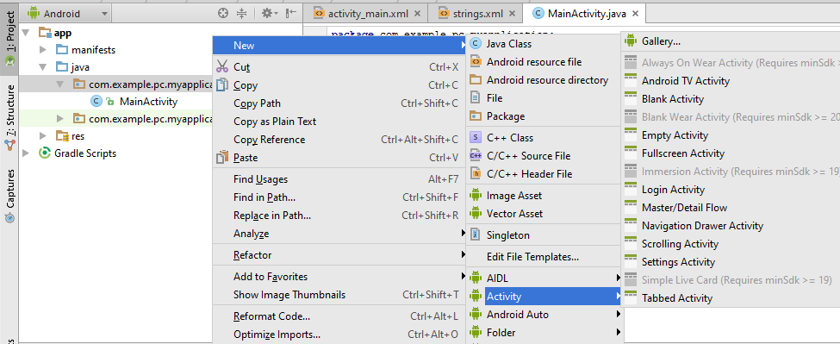
Creating new activity

Slide 11
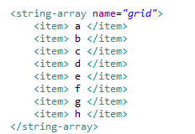
Array of values

Slide 12
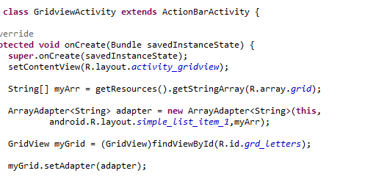
Second Activity: Binding array to grid view
Retrieve Array from strings file into array of strings
Use ArrayAdapter to Bind array of strings to the gridview
Get gridview
Set gridview’s Adapter with our Adapter
Notes:
listOfItem.add(String item);
toDoItemsAdapter.notifyDataSetChanged(); // the adapter
Where listOfItem is an Arraylist that will be linked to the gridview instead of using String[]

Slide 13
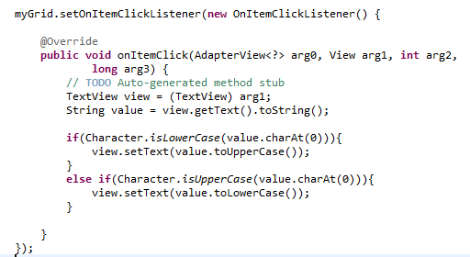
Second Activity: Grid Click Listener
Get textview and it’s value
Check if character is in a lower case then convert to upper
Check if character is in a upper case then convert to lower

Slide 14
Intents
Intents support interaction between any of the application components available on an Android device, no matter which application they’re part of.
Android supports explicit and implicit intents.
Explicit Intents: explicitly define the component which should be called by the Android system, by using the Java class as identifier.
Intent i = new Intent(this, ActivityTwo.class);
Implicit Intents: Implicit intents specify the action which should be performed and optionally data which provides content for the action.
The run time will choose the Activity to open
Intent i = new Intent(Intent.ACTION_VIEW, Uri.parse("http://www.vogella.com"));
Notes:
http://www.vogella.com/tutorials/AndroidIntent/article.html#intents_filter
Implicit intent: https://androiddesk.wordpress.com/tag/implicit-intent-using-an-example/

Slide 15
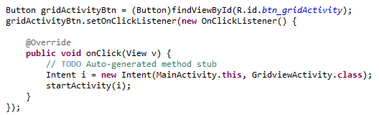
First Activity: How to navigate to another activity
Define an intent and start it
Notes:
You can use Intents to support interaction between any of the application components available on an Android device, no matter which application they’re part of. This turns a collection of independent components into a single, interconnected system.
Intents can also be used to broadcast messages across the system. Any application can register a Broadcast Receiver to listen for, and react to, these broadcast Intents.
The Intent can either explicitly specify the class to open, or include an action that the target should perform. In the latter case, the run time will choose the Activity to open

